Slide 1
TrackFit DMQB Project 2
Comparison of Google Fit user data
Pierre Delpy
Priya Caspar Groß

Slide 2
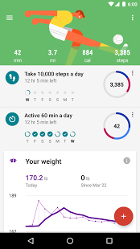
Aim of our application
Access Google Fit user data and store in database
Create summary statistics for all users in our database
Visualize your daily steps in comparison to all others in the database
Easily extendable and reusable

Slide 3
Frameworks used
Vaadin Web Application (Java)
1
User authentification Data request
Connection of modules
MongoDB
2
Data structure
Storage and handling
D3.js
3
Visualization

Slide 4
Please enter your title
Please enter the textPlease enter the text
A
Please enter the textPlease enter the text
Please enter the textPlease enter the text
B
C

Slide 5
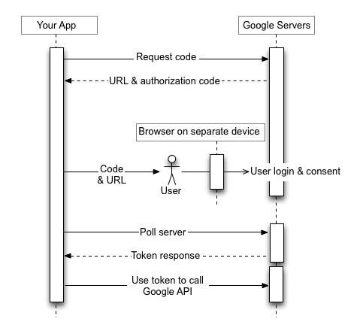
Authorization with Google OAuth2
User provides his Google username
User gets redirected google login/authorization page
User gives consent to requested data
TrackFit obtains acces Token from Google

Slide 6
Data request from Fit API
Uses standardized REST API Call
In thise case: Uses Google Rest Library for Java
Clusters data for days (last full finished day)
Data is received in JSON Format
JSON is sent to database handler

Slide 7
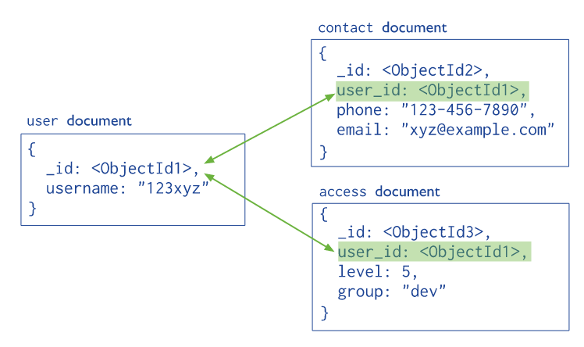
MongoDB
NoSQL database
Basic Structure: Collections and Documents
we used Java Driver version 3.4 for interacting with MongoDB

Slide 8
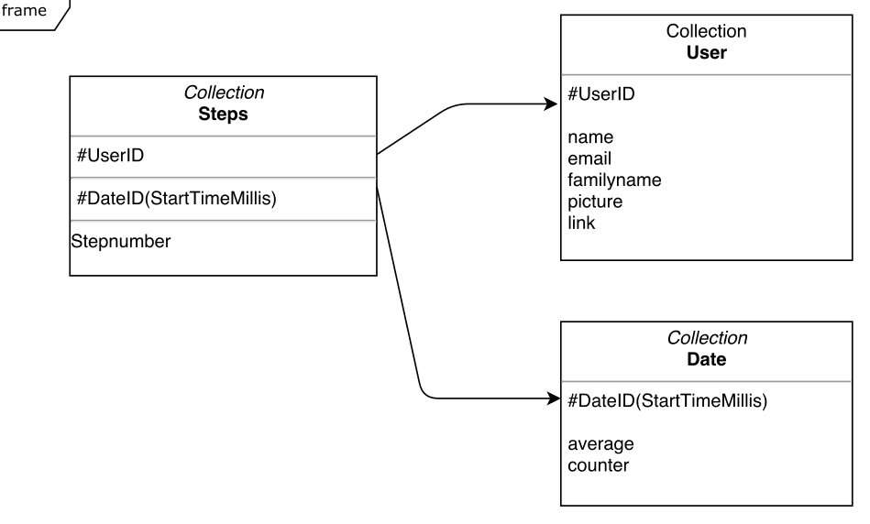
Data model
One database
3 Collections
Steps
username
Date
User
name
email
id

Slide 9
Data storage

Slide 10
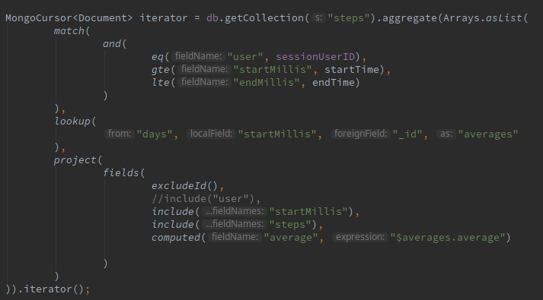
Data extraction

Slide 11
Data Gathering
Using google Fith API and OAuth2

Slide 12
Frameworks used
Web Application with Vaadin (Java)
Please enter the textPlease enter the textPlease enter the textPlease enter the textPlease enter the text

Slide 13

Please enter your title
Please enter the textPlease enter the textPlease enter the textPlease enter the textPlease enter the text

Slide 14
Please enter your title
Please enter the textPlease enter the textPlease enter the textPlease enter the textPlease enter the text

Slide 15
Please enter your title
Please enter your title
1
Please enter the textPlease enter the text
Please enter your title
Please enter the textPlease enter the text
2

Slide 16
Please enter your title
Please enter your title
1
Please enter the textPlease enter the text
Please enter your title
2
Please enter the textPlease enter the text
Please enter your title
3
Please enter the textPlease enter the text
Please enter your title
Please enter the textPlease enter the text
4

Slide 17
Please enter your title
Please enter your title
1
Please enter the textPlease enter the text
Please enter your title
Please enter the textPlease enter the text
2
Please enter your title
3
Please enter the textPlease enter the text
Please enter your title
Please enter the textPlease enter the text
4
Please enter your title
5
Please enter the textPlease enter the text

Slide 18
Please enter your title
Please enter your title
1
Please enter the textPlease enter the text
Please enter your title
Please enter the textPlease enter the text
2
3
Please enter your title
Please enter the textPlease enter the text
Please enter your title
Please enter the textPlease enter the text
4
5
Please enter your title
Please enter the textPlease enter the text
Please enter your title
Please enter the textPlease enter the text
6

Slide 19
Please enter your title
Please enter the textPlease enter the textPlease enter the textPlease enter the textPlease enter the text

Slide 20
Please enter your title
Please enter the textPlease enter the textPlease enter the textPlease enter the textPlease enter the text
Please enter the textPlease enter the textPlease enter the textPlease enter the textPlease enter the text

Slide 21

Please enter your title
Please enter the textPlease enter the textPlease enter the textPlease enter the textPlease enter the text

Slide 22
Please enter your title
Please enter the textPlease enter the textPlease enter the text
Please enter the textPlease enter the textPlease enter the text
Please enter the textPlease enter the textPlease enter the text

Slide 23
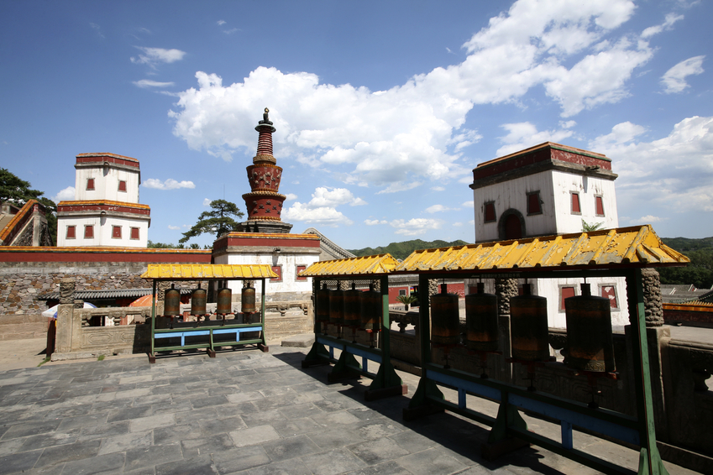
Please enter your title
Please enter the textPlease enter the textPlease enter the textPlease enter the textPlease enter the textPlease enter the text

Slide 24
Please enter your title
Please enter the textPlease enter the textPlease enter the textPlease enter the textPlease enter the text
Please enter the textPlease enter the textPlease enter the textPlease enter the textPlease enter the text

Slide 25

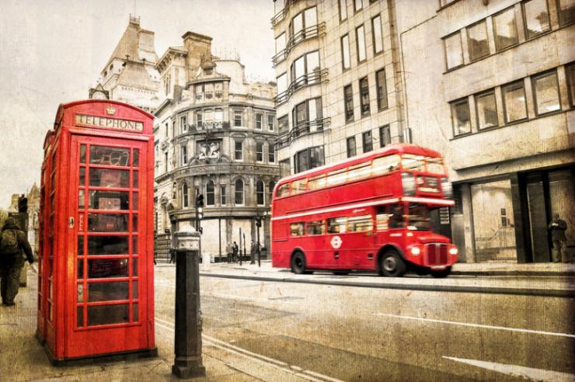

Please enter your title
Please enter the textPlease enter the textPlease enter the textPlease enter the textPlease enter the text

Slide 26
Please enter your title
1
Please enter the textPlease enter the textPlease enter the textPlease enter the textPlease enter the text
2
Please enter the textPlease enter the textPlease enter the textPlease enter the textPlease enter the text

Slide 27
Please enter your title
1
Please enter the textPlease enter the textPlease enter the textPlease enter the text
Please enter the textPlease enter the textPlease enter the textPlease enter the text
2
Please enter the textPlease enter the textPlease enter the textPlease enter the text
3

Slide 28
Please enter your title
1
Please enter the textPlease enter the textPlease enter the textPlease enter the text
2
Please enter the textPlease enter the textPlease enter the textPlease enter the text
3
Please enter the textPlease enter the textPlease enter the textPlease enter the text
4
Please enter the textPlease enter the textPlease enter the textPlease enter the text

Slide 29
Please enter your title
1
Please enter the textPlease enter the text
2
Please enter the textPlease enter the text
3
Please enter the textPlease enter the text
4
Please enter the textPlease enter the text
5
Please enter the textPlease enter the text

Slide 30
Please enter your title
Please enter the textPlease enter the text
1
2
Please enter the textPlease enter the text
3
Please enter the textPlease enter the text
4
Please enter the textPlease enter the text
5
Please enter the textPlease enter the text
6
Please enter the textPlease enter the text

Slide 31
Please enter your title
Please enter the textPlease enter the text
A
B
Please enter the textPlease enter the text

Slide 32
Please enter your title
Please enter the textPlease enter the text
A
Please enter the textPlease enter the text
Please enter the textPlease enter the text
B
C

Slide 33
Please enter your title
Please enter the textPlease enter the text
Please enter the textPlease enter the text
A
Please enter the textPlease enter the text
B
D
C
Please enter the textPlease enter the text

Slide 34
Please enter your title
Please enter the textPlease enter the text
Please enter the textPlease enter the text
A
E
B
Please enter the textPlease enter the text
D
C
Please enter the textPlease enter the text
Please enter the textPlease enter the text

Slide 35
Please enter your title
Please enter the textPlease enter the text
Please enter the textPlease enter the text
A
F
B
Please enter the textPlease enter the text
E
C
Please enter the textPlease enter the text
D
Please enter the textPlease enter the text
Please enter the textPlease enter the text

Slide 36
THANKS
Please enter your Subtitle

